Slide 1
CSE221
Structure and Interpretation of Computer Programs
Conventional Interfaces

Slide 2
sum-odd-squares (ref. scale-tree)
(define (scale-tree tree factor)
(cond (null? tree) nil)
((not (pair? tree)) (* tree factor))
(else (cons
))))
(scale-tree | (car | tree) | factor)
(scale-tree | (cdr | tree) | factor)

Slide 3
sum-odd-squares (ref. scale-tree)
(define (scale-tree tree factor)
(cond (null? tree) nil)
((not (pair? tree)) (* tree factor))
(else (cons
))))
(scale-tree | (car | tree) | factor)
(scale-tree | (cdr | tree) | factor)

Slide 4
sum-odd-squares (ref. scale-tree)
(define (scale-tree tree ????)
(cond (null? tree) ????)
((not (pair? tree)) ????)
(else (?????
))))
(scale-tree | (car | tree) | ?????)
(scale-tree | (cdr | tree) | ?????)
What do we need here??????

Slide 5
sum-odd-squares (ref. scale-tree)
When no data, it should return a ZERO
(define (scale-tree tree ????)
(cond (null? tree) 0)
((not (pair? tree)) ????)
(else (?????
))))
(scale-tree | (car | tree) | ?????)
(scale-tree | (cdr | tree) | ?????)
What do we need here??????

Slide 6
sum-odd-squares (ref. scale-tree)
If data odd, square else return ZERO
(define (scale-tree tree ????)
(cond (null? tree) 0)
((not (pair? tree))
(if (odd? tree) (square tree) 0))
(else (?????
))))
(scale-tree | (car | tree) | ?????)
(scale-tree | (cdr | tree) | ?????)
What do we need here??????

Slide 7
sum-odd-squares (ref. scale-tree)
(define (scale-tree tree ????)
(cond (null? tree) 0)
((not (pair? tree))
(if (odd? tree) (square tree) 0))
(else (+
))))
(scale-tree | (car | tree) | ?????)
(scale-tree | (cdr | tree) | ?????)
Add the data with recursive calls
What do we need here??????

Slide 8
sum-odd-squares
(define (sum-odd-squares tree)
(cond (null? tree) 0)
((not (pair? tree))
(if (odd? tree) (square tree) 0))
(else (+
))))
Change name
(sum-odd-squares | (car | tree) | )
(sum-odd-squares | (cdr | tree) | )

Slide 9
???
(define (??? n)
(define (next k)
(if (> k n)
nil
(let ((f (fib k)))
(if (even? f)
(cons f (next (+ k 1)))
(next (+ k 1))))
)
)
(next 0))

Slide 10
Even-fibs
(define (even-fibs n)
(define (next k)
(if (> k n)
nil
(let ((f (fib k)))
(if (even? f)
(cons f (next (+ k 1)))
(next (+ k 1))))
)
)
(next 0))

Slide 11
Abstract Description of even-fibs
Enumerate the integers from 0 to n
●
Compute Fibonacci number of each integer
●
Filter them selecting even ones
●
Accumulate result using cons, starting with empty list
●

Slide 12
Enumerate the integers from 0 to n
(0 1 2 3 4 5 6 7 8 9 10)
Compute Fibonacci number of each integer
(0 1 1 2 3 5 8 13 21 34 55)
●
Filter them selecting even ones
0, 2, 8, 34
●
Accumulate result
(0 2 8 34)
●

Slide 13
sum-odd-squares
(define | (sum-odd-squares tree)
(cond | (null? tree) 0)
 | ((not (pair? tree))
 | (if (odd? tree) (square | tree) | 0))
 | (else (
 | (sum-odd-squares (car | tree) | )
 | (sum-odd-squares (cdr | tree) | )
))))

Slide 14
sum-odd-squares
(define (sum-odd-squares tree)
(cond (null? tree) 0)
((not (pair? tree))
(if (odd? tree) (square tree) 0))
(else (+
))))
(sum-odd-squares | (car | tree) | )
(sum-odd-squares | (cdr | tree) | )

Slide 15
Abstract Description of sum-odd-squares
Enumerate the leaves of a tree
●
Filter them selecting odd ones
●
Square each of selected odd ones
●
Accumulate result using +, starting with 0
●

Slide 16
Enumerate the leaves of a tree
(list 1 (list 2 (list 3 4)) 5)
(1 2 3 4 5)
Filter them selecting odd ones
(1 3 5)
●
Square each of selected odd ones
(1 9 25)
●
Accumulate result using +
35
●

Slide 17






Enumerate tree leaves
Pipeline / Stages
Filter: odd?
map square
Accumulate
+,0
Enumerate
integers
map
fib
Filter Even?
Accumulate cons,()

Slide 18
enumerate-interval and
enumerate-tree
(enumerate-interval 1 7)
(1 2 3 4 5 6 7)

Slide 19
enumerate-interval
(define (enumerate-interval low high)
(if (> low high)
nil
(cons low
(enumerate-interval (+ low 1) high)
)))

Slide 20
enumerate-interval and
enumerate-tree
(enumerate-interval 1 7)
(1 2 3 4 5 6 7)
(enumerate-tree (list 1 (list 2 3) 4))
(1 2 3 4)

Slide 21
enumerate-tree
(define (enumerate-tree tree)
(cond ((null? tree) nil)
((not (pair? tree)) (list tree)
(else (append
))
(enumerate-tree | (car | tree))
(enumerate-tree | (cdr | tree))))

Slide 22
filter
(filter odd? (list 1 2 3 4 5))
(1 3 5)

Slide 23
filter
(define (filter predicate sequence)
(cond ((null? sequence) nil)
((predicate (car sequence))
(cons (car sequence)
(filter predicate (cdr sequence)))
(else (filter predicate (cdr sequence)))
))

Slide 24
accumulate
(accumulate 15 | + | 0 | (list | 1 | 2 | 3 | 4 | 5))
(accumulate 120 | * | 1 | (list | 1 | 2 | 3 | 4 | 5))
(accumulate cons nil (list 1 2 3 4 5))
(1 2 3 4 5)

Slide 25
accumulate
(define (accumulate op initial sequence)
  (if (null? sequence)
  initial
  (op (car sequence)(accumulate op initial
  (cdr sequence))
  )
  )
  )

Slide 26
sum-odd-squares
(define (sum-odd-squares tree)
(cond (null? tree) 0)
((not (pair? tree))
(if (odd? tree) (square tree) 0))
(else (+
        (sum-odd-squares (car tree) )
        (sum-odd-squares (cdr tree) )
))))

Slide 27
sum-odd-squares
(define (sum-odd-squares tree)
??
)

Slide 28
sum-odd-squares
(define (sum-odd-squares tree)
(enumerate-tree tree)
)

Slide 29
sum-odd-squares
(define (sum-odd-squares tree)
(filter odd?
(enumerate-tree tree)
))

Slide 30
sum-odd-squares
(define (sum-odd-squares tree)
(map square
(filter odd?
(enumerate-tree tree)
)))

Slide 31
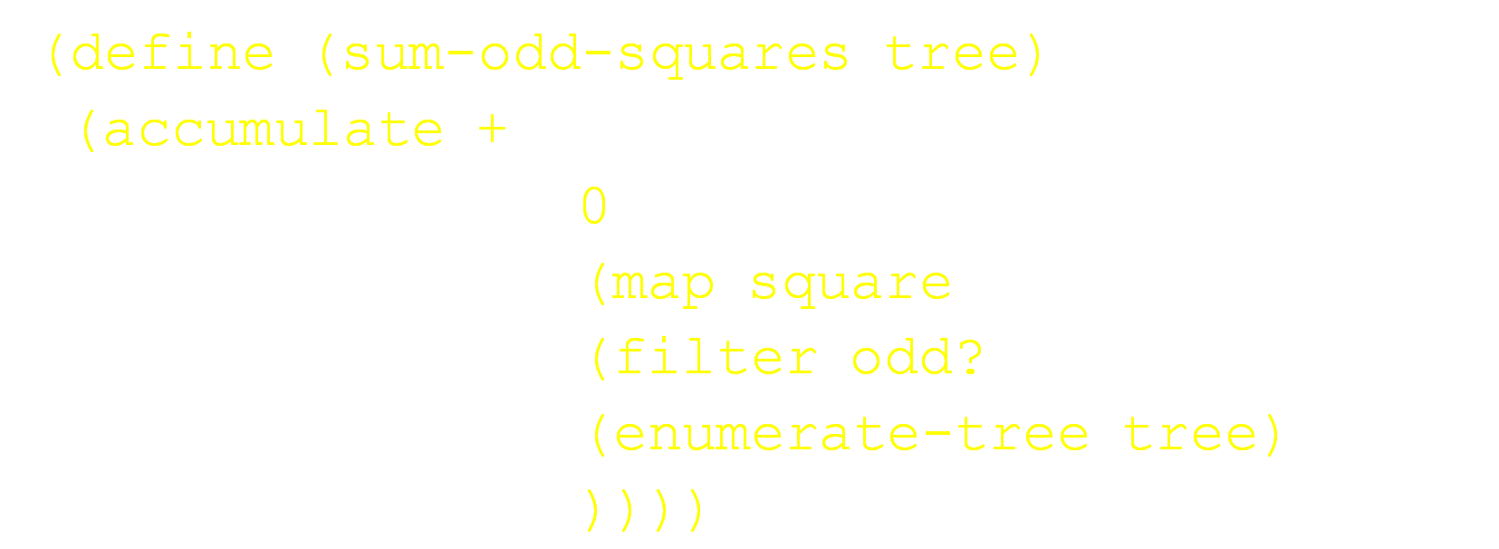
sum-odd-squares

Slide 32
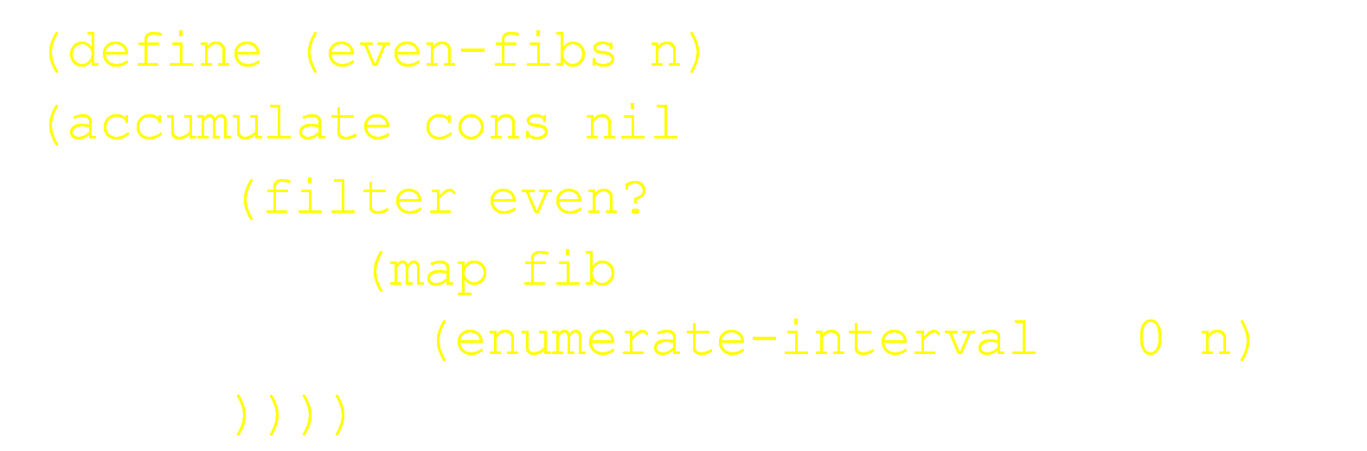
even-fibs

Slide 33
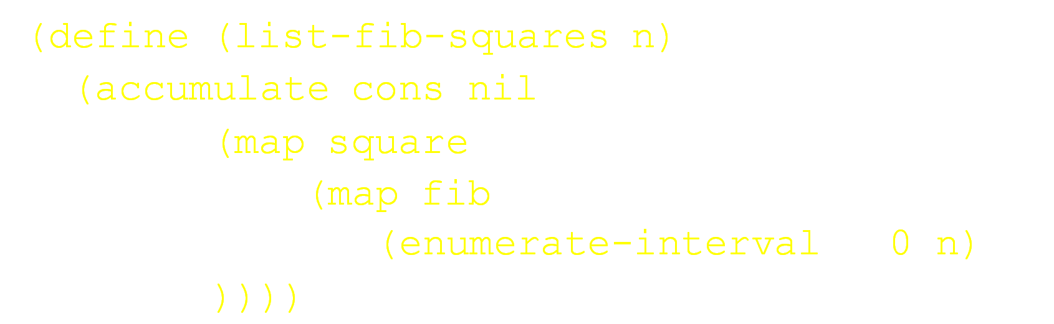
list-fib-squares

Slide 34
prod-sqr-odd-elements
(define (prod-sqr-odd-elements sequence) (accumulate * 1
    (map square
    (filter odd? sequence)
    )))

Slide 35
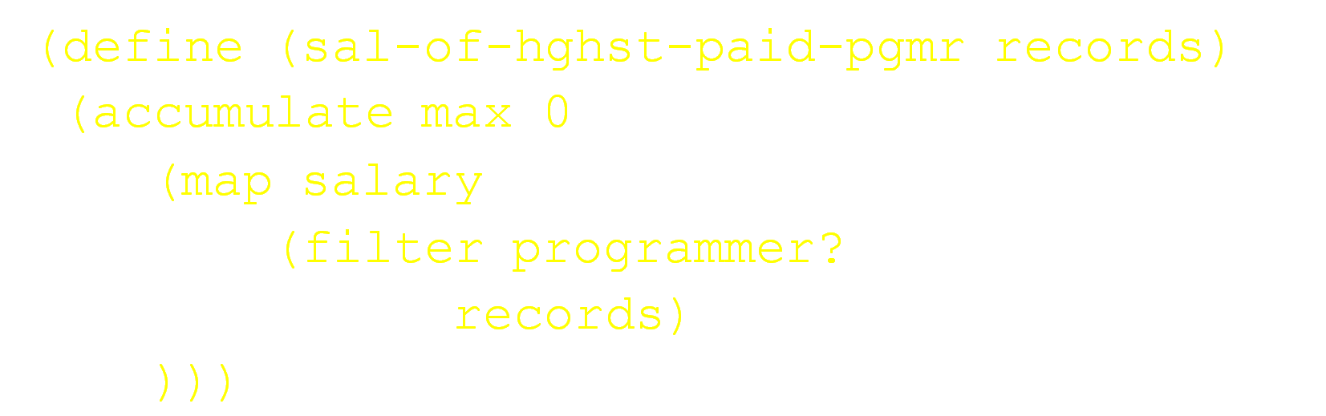
sal-of-hghst-paid-pgmr

